Slide 1
Project 2 – UI presentation
Team 3:
Uma Mahesh(Admin)- 170003
Jawahar(Client) – 170004
Preetinder(Client) – 170040
Mohan Akshay(Client) - 170049

Slide 2
Team roles
Mahesh
Client and Admin welcome windows.
Jawahar
Client Brainstorming window.
Preetinder
Admin Brainstorming window.
Mohan Akshay
Client login window.

Slide 3
ADMIN windows

Slide 4
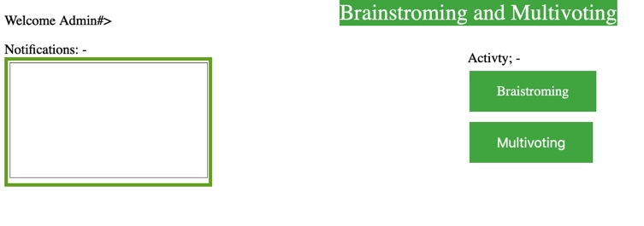
Admin- welcome window

Slide 5
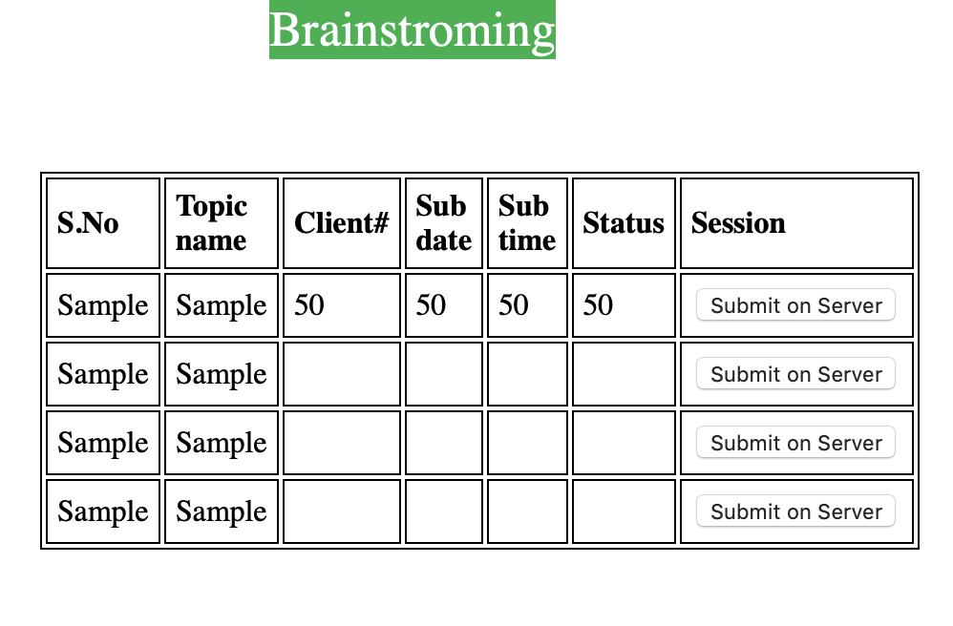
Admin -brainstorming

Slide 6
Client windows

Slide 7
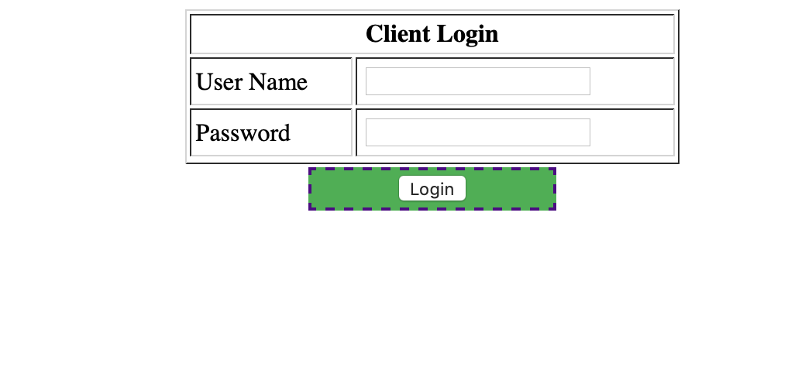
Client login

Slide 8
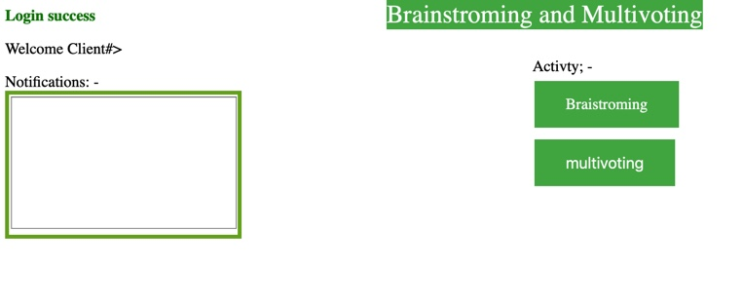
Client welcome window

Slide 9
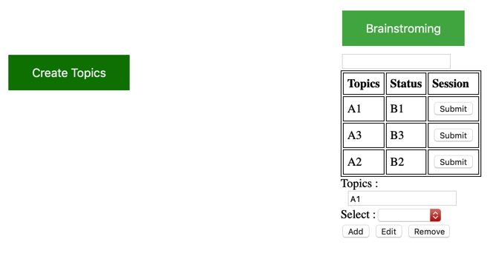
Client brainstorming window

Slide 10
Thanks for watching our team presentation ☺

